Slide 1
The Rise of Bengali Identity Politics & Awami League

Slide 2
Lecture Outline
Introduction
Alliance of United Front.
Twenty-One Point Program.
Result of the Election in 1954.
Importance of Election in 1954.
Rise of United Front in1954 Election.
Fall of Muslim League Election in 1954
Reactions and impacts
Conclusion

Slide 3
While the West Pakistan political scene was largely dominated by certain influential persons or families (Pirs, Zamindars, Khans and Nawabs), East Pakistan presented a different picture.
Here, party politics first crystalized itself under the leadership of the East Pakistan Awami Muslim League, which played a prominent role in the language movement of the province in 1952, and in the defeat of the Muslim League in the 1954 elections by forming an electoral alliance with the minor parties. The Awami League was a constituent of the United Front cabinet in 1954 which was dismissed by the Central Government.

Slide 4
The Awami League claims to be an All-Pakistan party it has been primarily based in the Eastern Wing and its success in the West is still limited. The Awami League leader, Sheikh Mujibur Rahman, gave a new turn to Pakistan politics when he put forward a six-point program which would allocate maximum power to the province, and at the same time reduce the strength of the Central Government.

Slide 5
The 1954 Election:
The 1954 election marked the rejection of the national elite by the Bengali electorate . The election strategy of the vernacular elite was to maximize popular support by closing the divided ranks and drawing up a program upon which there was general consensus.

Slide 6
Before the election campaign the Bengali counter-elite was fragmented into separate political parties. In addition to the Awami League, the major political party of the counter-elite, there were several other parties to the left and right.

Slide 7
There was Nizam-i-Islam, founded in 1950, which stood for the establishment of an Islamic state based on the principles of the Holy Quran. The Nizam consisted mainly of orthodox religious leaders and its socioeconomic program was the right of the Awami League.
To the left of the party stood the Ganatantri Dal. In addition there was the Krishak Sramik Party(KSP) composed mainly of AK Fazlul Haq’s personal followers and allies, and similar to the Awami League in its ideology and program.

Slide 8
To strengthen their position , the political parties decided to form an electoral alliance.
A United Front comprising the Awami League, the KSP, the Nizam-i-Islam , and the Ganatantri Dal was formed in 1953; and a common election manifesto , the 21-Point formula was drawn up.
In other words, the United Front was composed of four political parties of East Bengal, namely Awami Muslim League, Krishak Sramik Party, Nezam-e-Islam and Ganatantri Dal. The Front was formed on 4 December 1953 by the initiative of AK Fazlul Huq of Krishak Sramik Party, Maulana Abdul Hamid Khan Bhasani and Huseyn Shaheed Suhrawardy of Awami Muslim League. The 21-point package program in the election manifesto adopted by the United Front runs as follows:

Slide 9
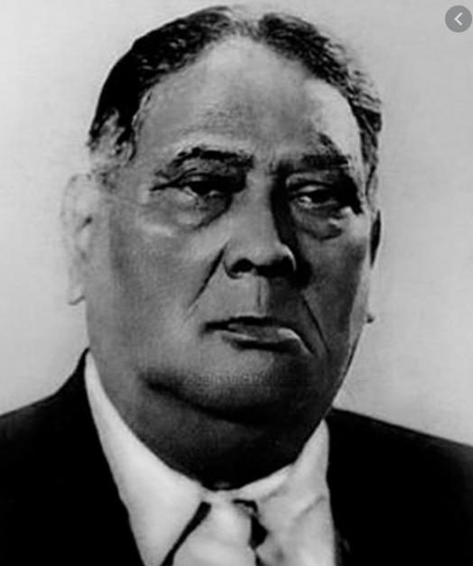

Slide 10
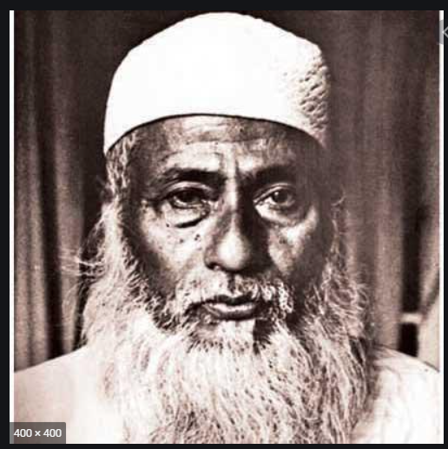
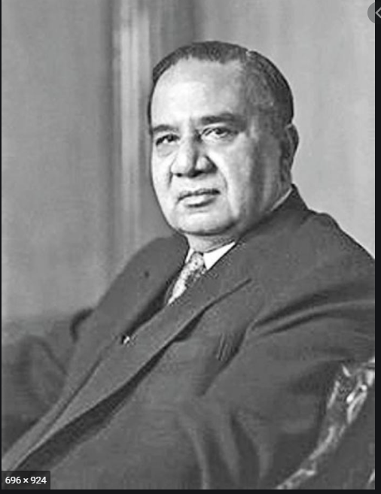

Slide 11
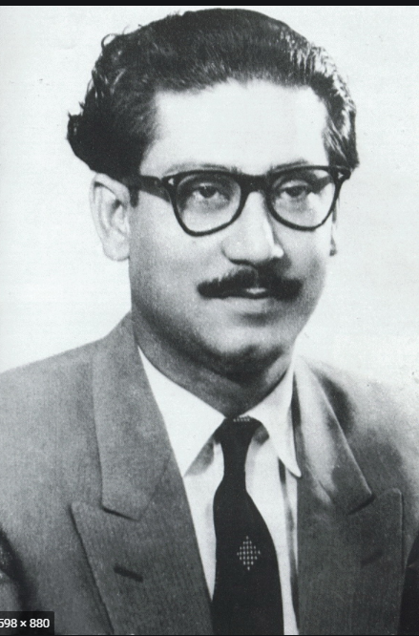

Slide 12
21-Point Program:
1. To recognize Bangla as one of the State Languages of Pakistan;
2. To abolish without compensation zamindari and all rent receiving interest in land, and to distribute the surplus lands amongst the cultivators; to reduce rent to a fair level and abolish the certificate system of realizing rent;
3. To nationalize the jute trade and bring it under the direct control of the government of East Bengal, secure fair price of jute to the growers and to investigate into the jute-bungling during the Muslim League regime to punish those found responsible for it
4. To introduce co-operative farming in agriculture and to develop cottage industries with full government subsidies;

Slide 13
5. To start salt industry (both small and large scale) in order to make East Bengal self-sufficient in the supply of salt, and to investigate into the salt-bungling during the Muslim League regime to punish the offenders;
6.To rehabilitate immediately all the poor refugees belonging to the artisan and technician class;
7. To protect the country from flood and famine by means of digging canals and improving irrigation system;
8. To make the country self-sufficient by modernizing the method of cultivation and industrialization, and to ensure the rights of the laborer as per ILO Convention;

Slide 14
9. To introduce free and compulsory primary education throughout the country and to arrange for just pay and allowances to the teachers;
10. To restructure the entire education system, introduce mother tongue as the medium of instruction, remove discrimination between government and private schools and to turn all the schools into government aided institutions;
11. To repeal all reactionary laws including those of the Dhaka and Rajshahi Universities and to make them autonomous institutions; to make education cheaper and easily available to the people;
12. To curtail the cost of administration and to rationalize the pay scale of high and low paid government servants. The ministers shall not receive more than 1000 taka as monthly salary;

Slide 15
13. To take steps to eradicate corruption, nepotism and bribery, and with this end in view, to take stocks of the properties of all government officers and businessmen from 1940 onward and forfeit all properties the acquisition of which is not satisfactorily accounted for;
14. To repeal all Safety and Preventive Detention Acts and release all prisoners detained without trial, and try in open court persons involved in anti-state activities; to safeguard the rights of the press and of holding meetings;
15. To separate the judiciary from the executive;
16. To locate the residence of the chief minister of the United Front at a less costly house, and to convert Burdwan House into a students hostel now, and later, into an institute for research on Bangla language and literature;
17. To erect a monument in memory of the martyrs of the Language Movement on the spot where they were shot dead, and to pay compensation to the families of the martyrs;

Slide 16
18. To declare 21st of February as ‘Shaheed Day’ and a public holiday;
19. The Lahore Resolution proposed full autonomy of East Bengal leaving defense, foreign affairs and currency under the central government. In the matter of defense, arrangements shall be made to set the headquarters of the army in West Pakistan and the naval headquarters in East Bengal and to establish ordnance factories in East Bengal, and to transform Ansar force into a full-fledged militia equipped with arms;
20. The United Front Ministry shall on no account extend the tenure of the Legislature and shall resign six months before the general elections to facilitate free and fair elections under an Election Commission;
21. All casual vacancies in the Legislature shall be filled up through by-elections within three months of the vacancies, and if the nominees of the Front are defeated in three successive by-elections, the ministry shall resign from office.

Slide 17
In the elections held from 8 to 12 March, 1285 candidates contested for 304 seats, 5 seats having been won uncontested. Of them, 986 were Muslim candidates for 228 seats, 101 Hindu candidates for 30 seats, and 151 scheduled caste candidates for 36 seats. The seats for the non-Muslims were contested by candidates mainly from the Pakistan National Congress, United Progressive Party and the Scheduled Caste Federation. The total electors numbered 1,97,48,568 of whom 73,44,216 (37.19%) cast their votes. The lower turnout was ascribed to poor communications in rural areas and the reluctance of conservative Muslim women to come out of their houses.

Slide 18
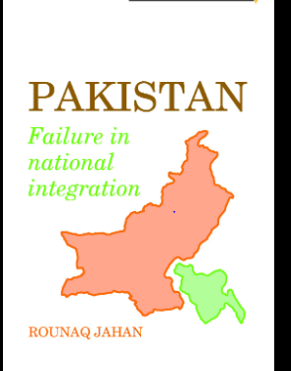
Professor Rounaq Jahan in her book titled, Pakistan: Failure in National Integration, commented that :
The United Front and its 21-Point Manifesto foreshadowed later political trends in East Pakistan (Page: 45).

Slide 19
The elections resulted in a landslide victory for the United Front which won 228 seats in a House of 309 (including nine reserved seats for women). On the other hand, the Muslim League, the party in power directly or indirectly ever since 1937, managed to get only 7 seats. Of the total of 228 elected Front members, 143 belonged to Awami Muslim League, 48 to Krishak Sramaik Party, 22 to Nezam-I-Islam, 13 to Ganatantri Dal and 2 to Khilafat-e-Rabbani Party. Of the non-Muslim seats, Congress got 25, Scheduled Caste Federation 27, and the United Front of the Minorities 13

Slide 20
What were the causes of the victory of the United Front?
What were the factors/causes/reasons behind the defeat/fall of the Muslim League?
Crises of the Pakistani state : 1) legitimacy crisis, 2)identity crisis,
3) participation crisis ,4) integration crisis, 5)penetration crisis, and 6) distribution crisis.
Civil-military relations: Objective control model-politics control guns, Subjective control of the military-guns control politics.
Consequences: Growth of Bengali cultural-linguistic nationalism in lieu of religion-based nationalism, centripetal vs. centrifugal forces

Slide 21
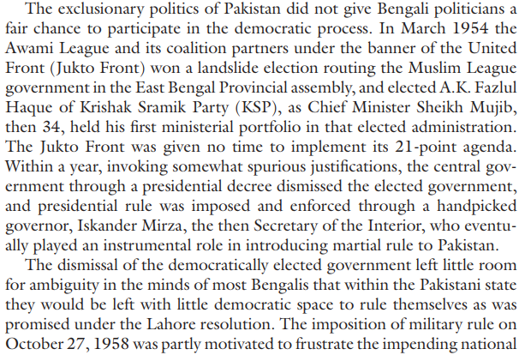

Slide 22
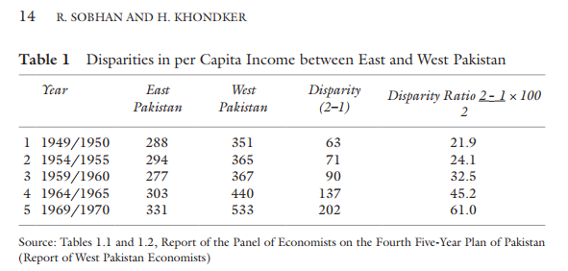

Slide 23
References:
Rehman Sohan and Habibul Khondker, “The Political and Economic Context Underlying the Emergence of Bangladesh” in Khondker et.al (eds.), The Emergence of Bangladesh: Interdisciplinary Perspectives , Singapore: Palgrave Macmillan , 2022 , pp.7-24.
Rounaq Jahan, Pakistan: Failure in National Integration, UPL: Dhaka, 1994.

